Slide 1
UCM Upsilon Pi Epsilon
Git Workshop
University of Central Missouri, Fall 2024

Slide 2
Git History
Created by Linus Torvalds, creator of Linux, in 2005
Came out of Linux development community
Designed to do version control on Linux kernel
Goals of Git:
Speed
Support for non-linear development (thousands of parallel branches)
Fully distributed
Able to handle large projects efficiently
(A "git" is a cranky old man. Linus meant himself. I would agree with that assessment)

Slide 3
Other Version Control
Git isn’t the only game in town, just the most popular.
Mercurial - Similar to git, used heavily on Python development.
Perforce
Older:
SVN, CVS, Clearcase, RCS

Slide 4
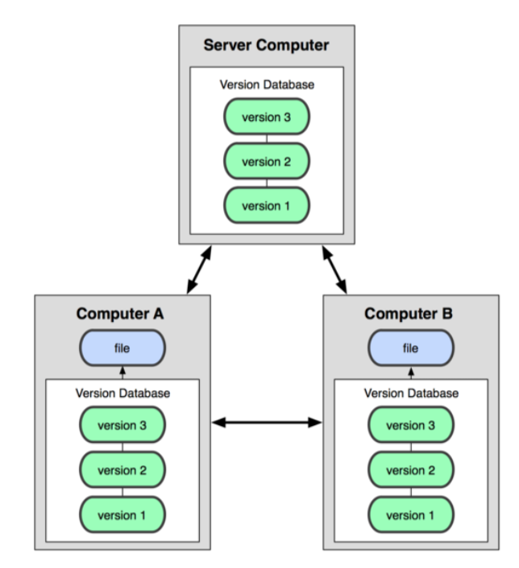
Distributed Version Control
In git, mercurial, etc., you don't "checkout" from a central repo
You "clone" it and "pull" changes from it
Your local repo is a complete copy of everything on the remote server
Yours is "just as good" as theirs
Many operations are local:
Check in/out from local repo
Commit changes to local repo – local repo keeps version history
When you're ready, you can "push" changes back to server
images taken from http://git-scm.com/book/en/

Slide 5
Git Commit IDs
In Git, each user has their own copy of the repo, and commits changes to their local copy of the repo before pushing to the central server.
So Git generates a unique SHA-1 hash (40 character string of hex digits) for every commit.
Refers to commits by this ID rather than a version number.
Often we only see the first 7 characters:
1677b2d Edited first line of readme 258efa7 Added line to readme 0e52da7 Initial commit

Slide 6
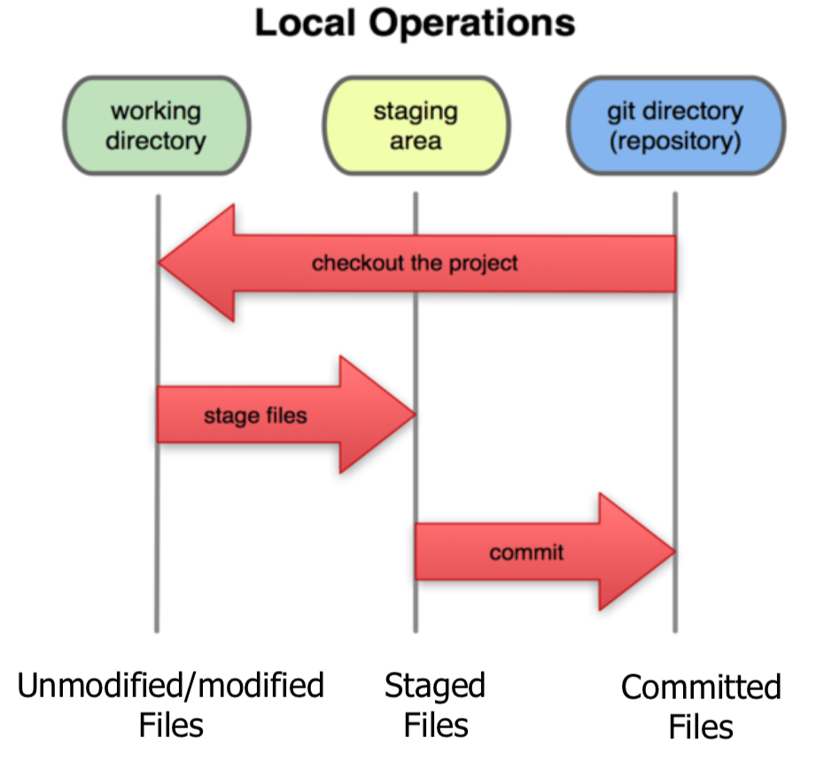
Local Git Areas
In your local copy on git, files can be:
In your local repo
committed
Checked out and modified, but not yet committed
working copy
Or, in-between,
"staging" area
Staged files are ready to be committed.
A commit saves a snapshot of all staged state.
images taken from http://git-scm.com/book/en/

Slide 7
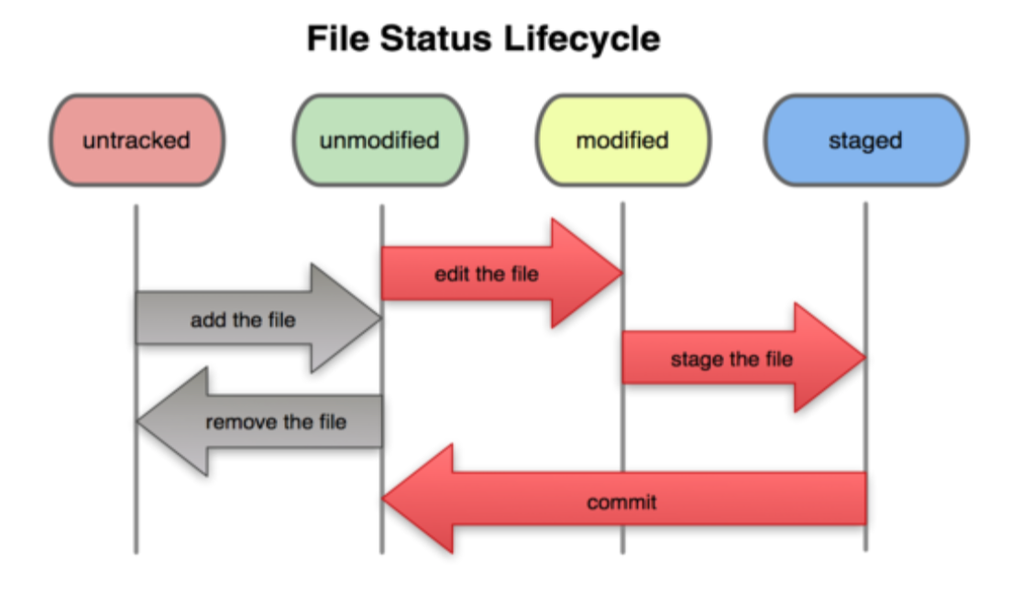
Basic Git Workflow
Modify files in your working directory.
Stage files, adding snapshots of them to your staging area.
Commit, which takes the files in the staging area and stores that snapshot permanently to your Git directory.
images taken from http://git-scm.com/book/en/

Slide 8
Workshop Screenshots

Slide 9
Section 2
Configuration Screenshots

Slide 10
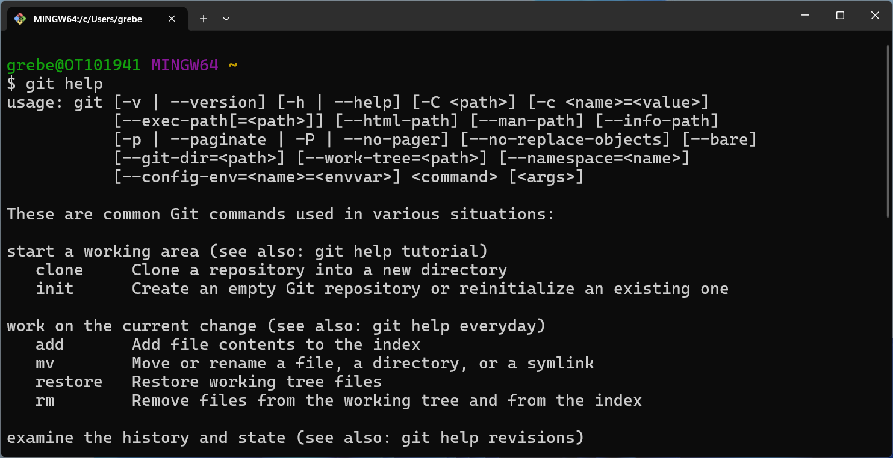

Slide 11
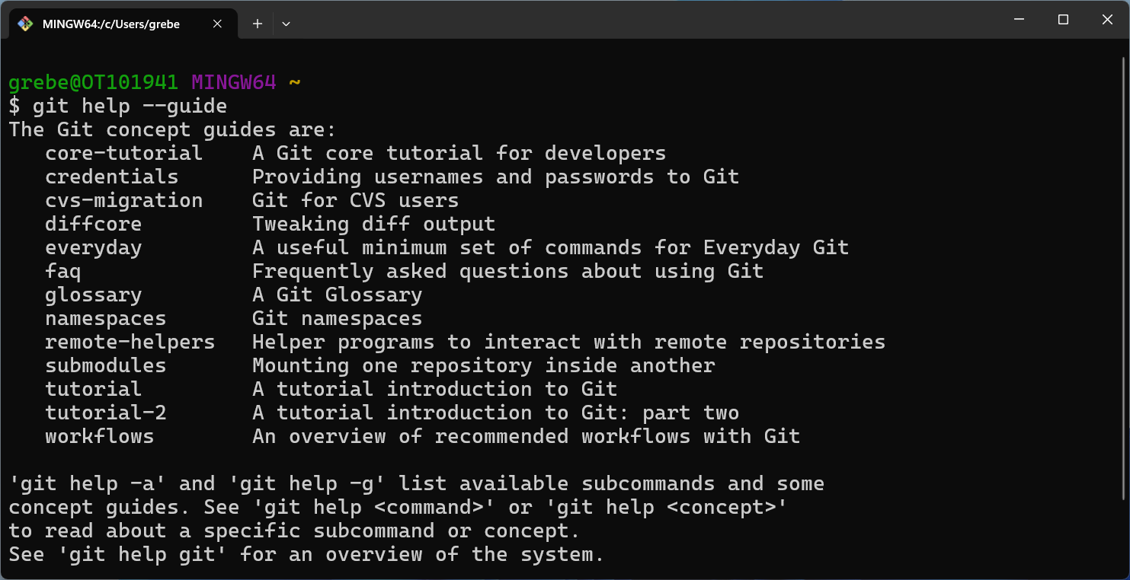

Slide 12
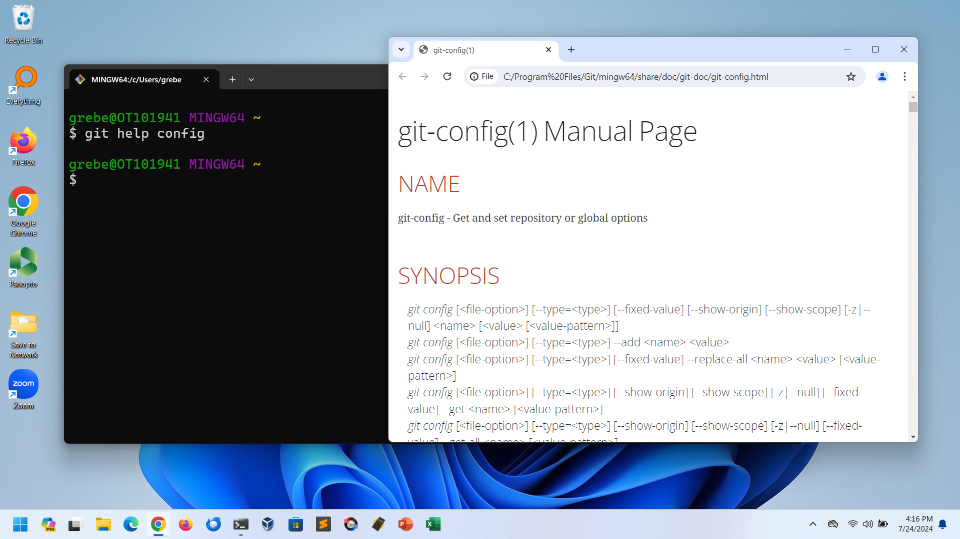

Slide 13
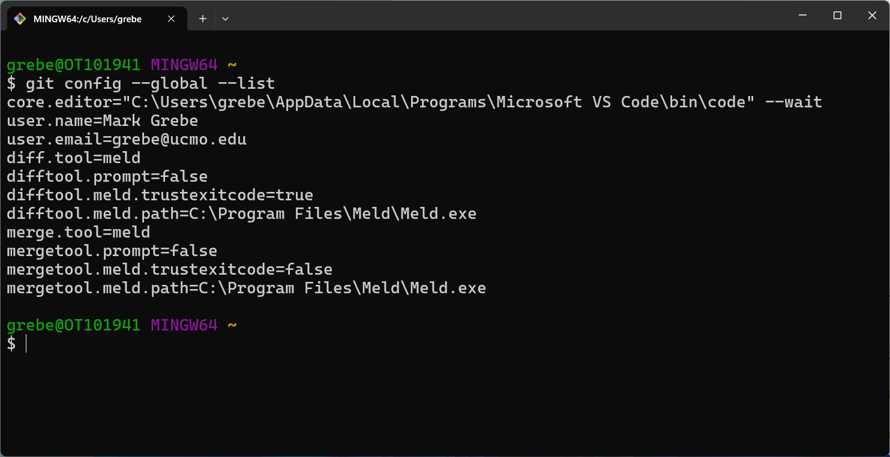

Slide 14
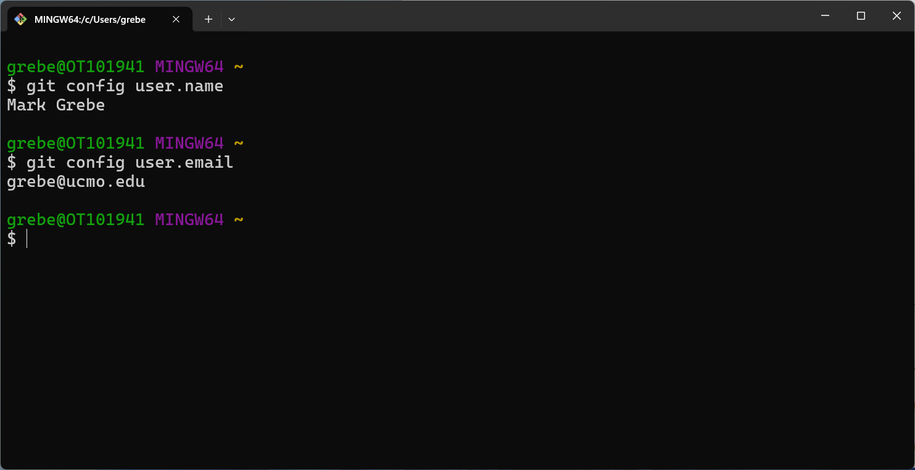

Slide 15
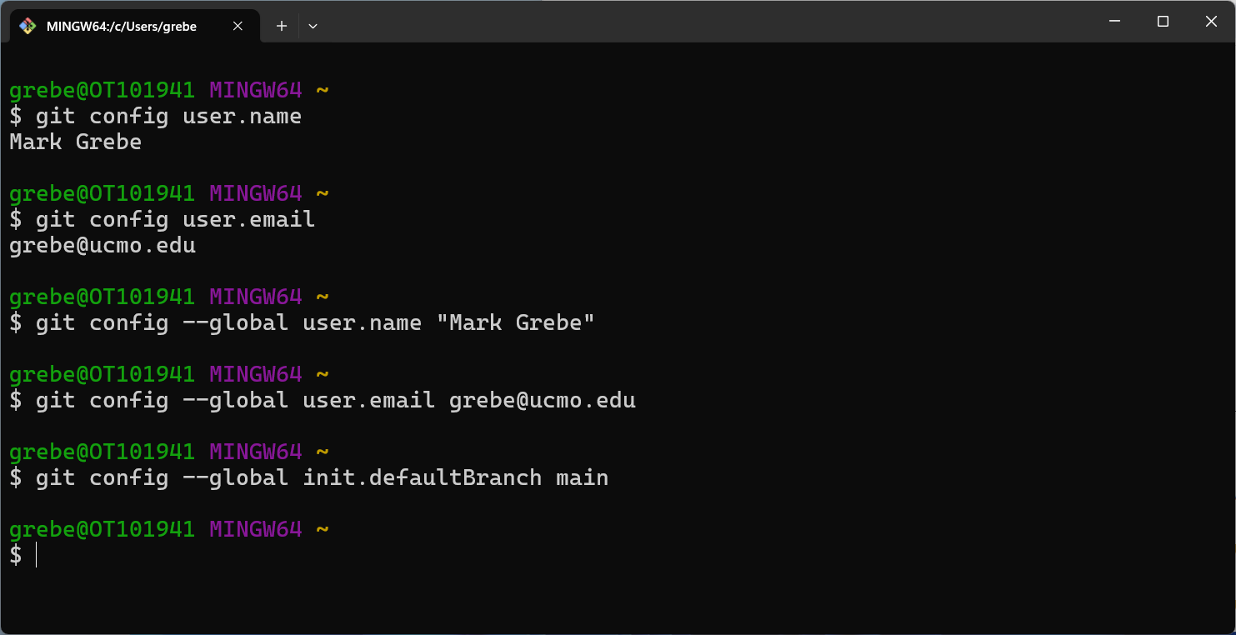

Slide 16
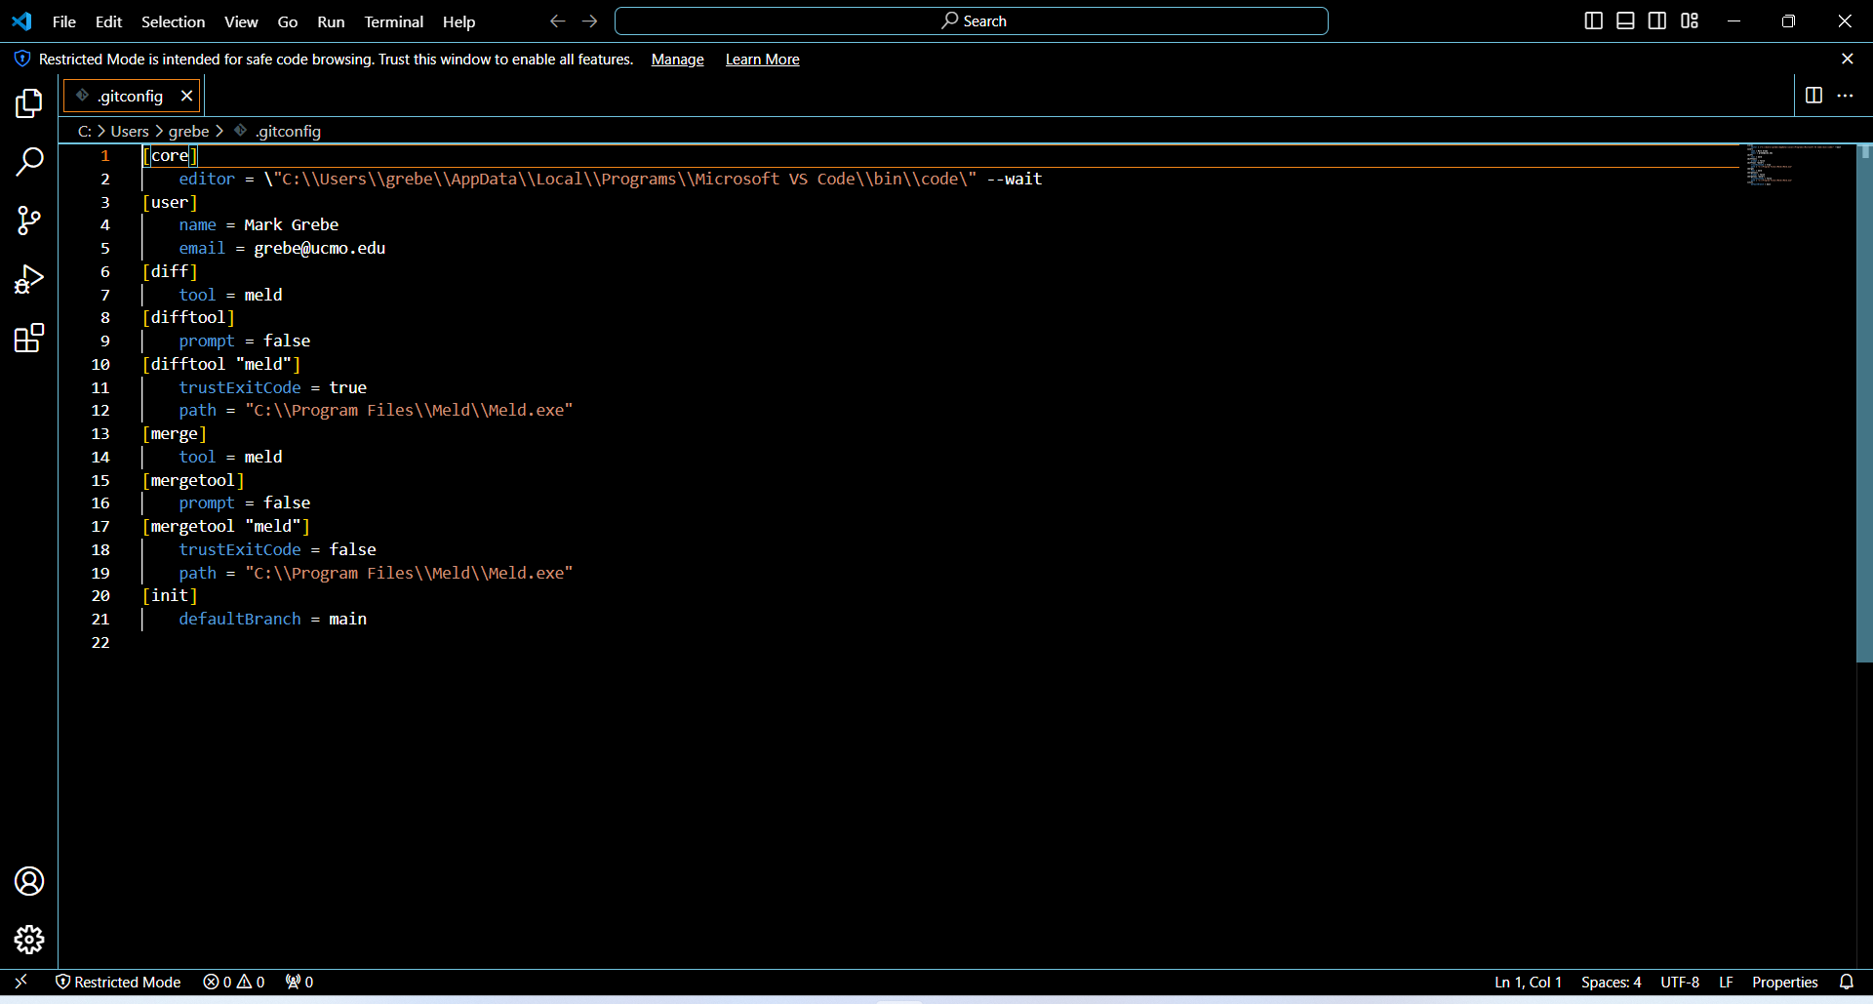

Slide 17
Section 3
Git 101
Screenshots

Slide 18
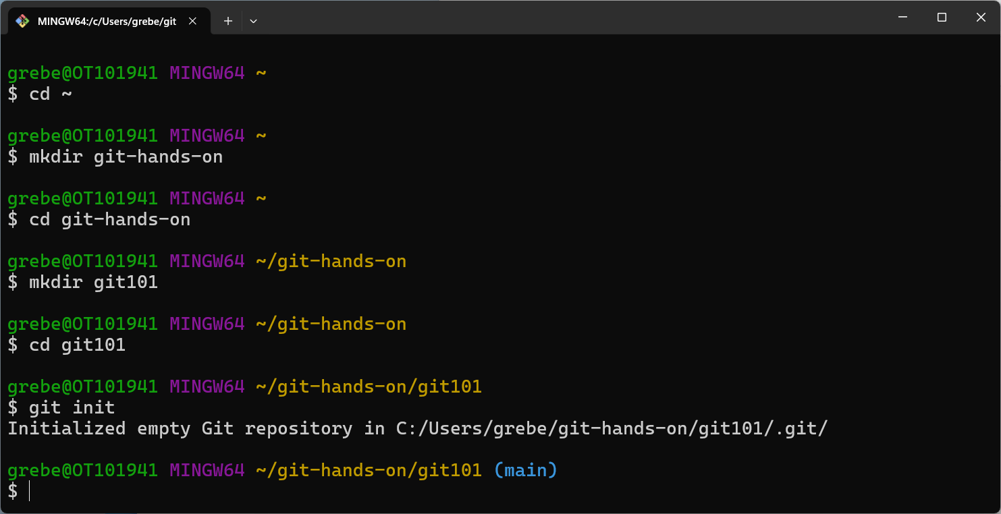

Slide 19
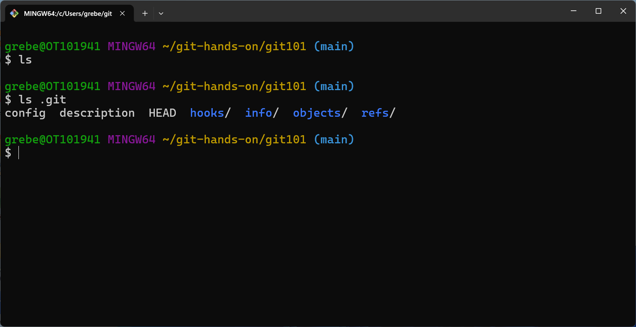

Slide 20
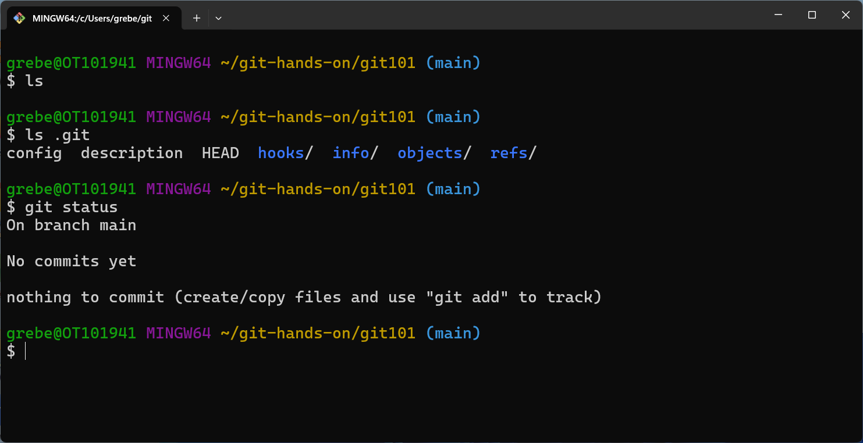

Slide 21
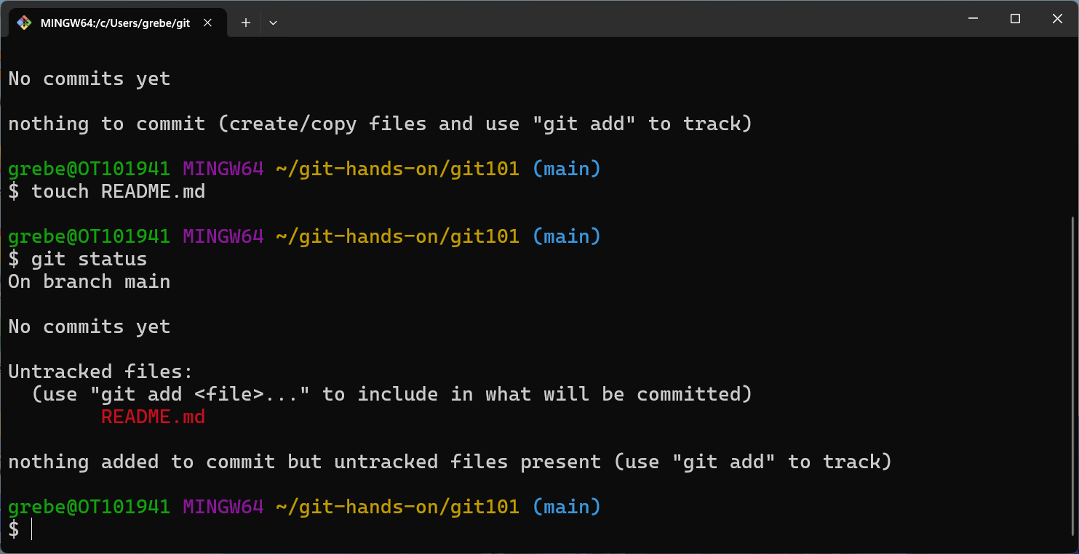

Slide 22
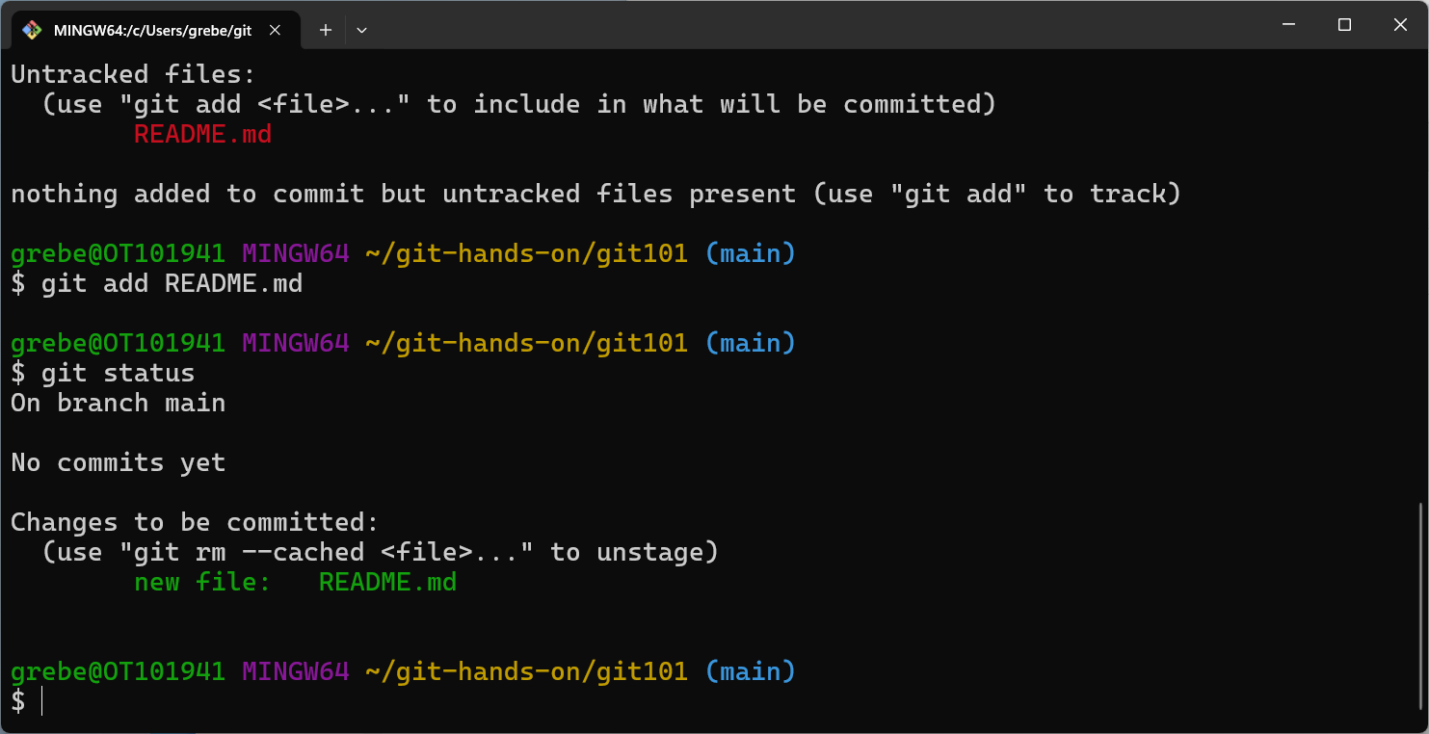

Slide 23
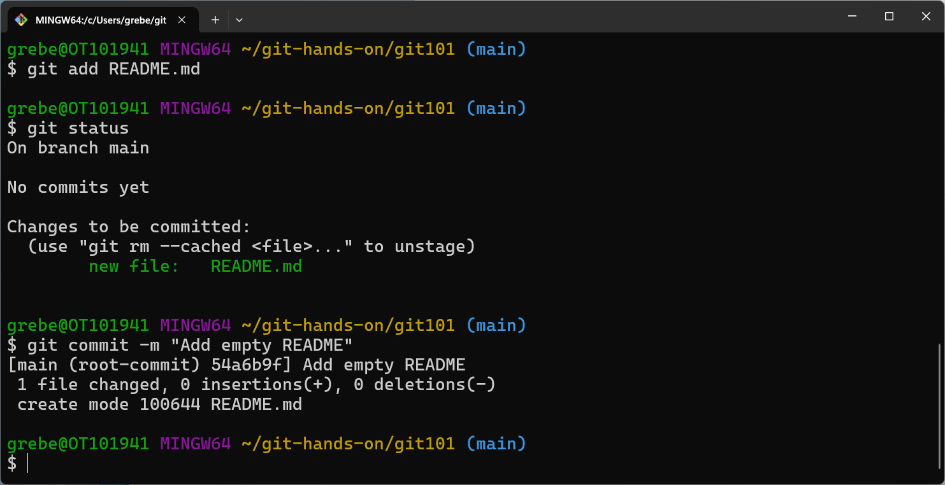

Slide 24
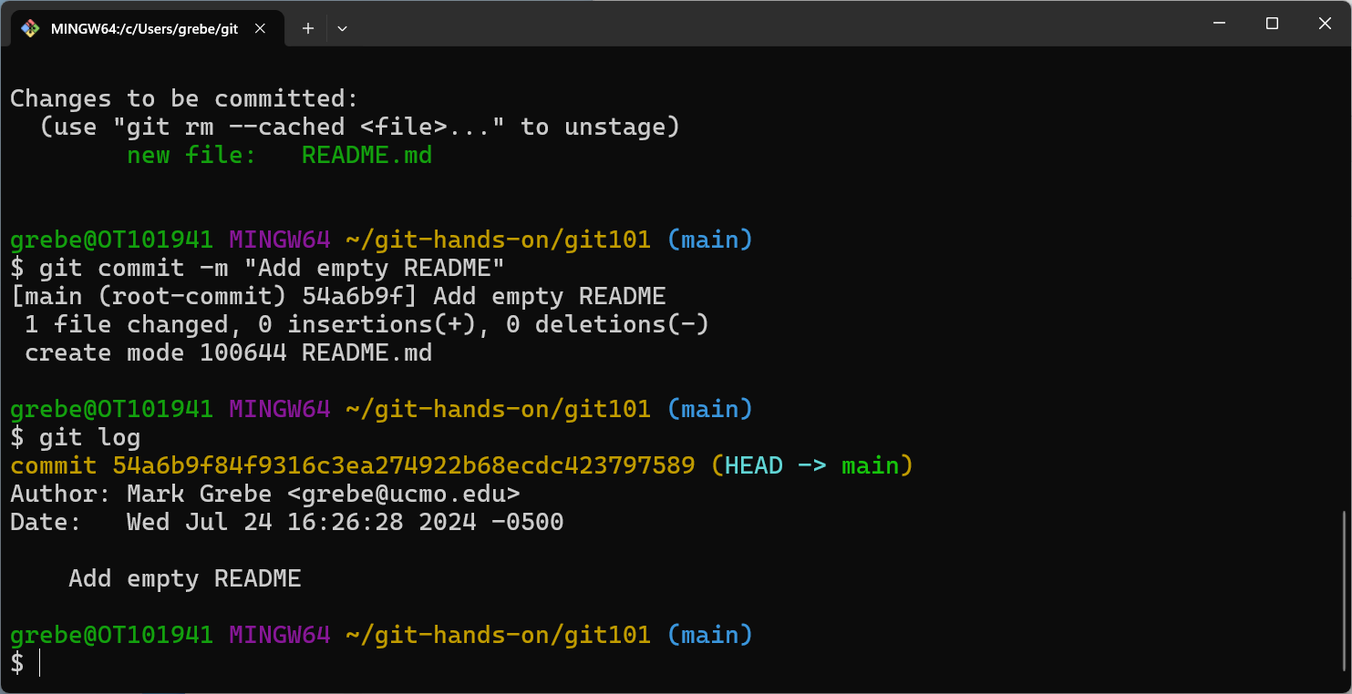

Slide 25
Section 4
Clone A Remote Repo
Screenshots

Slide 26
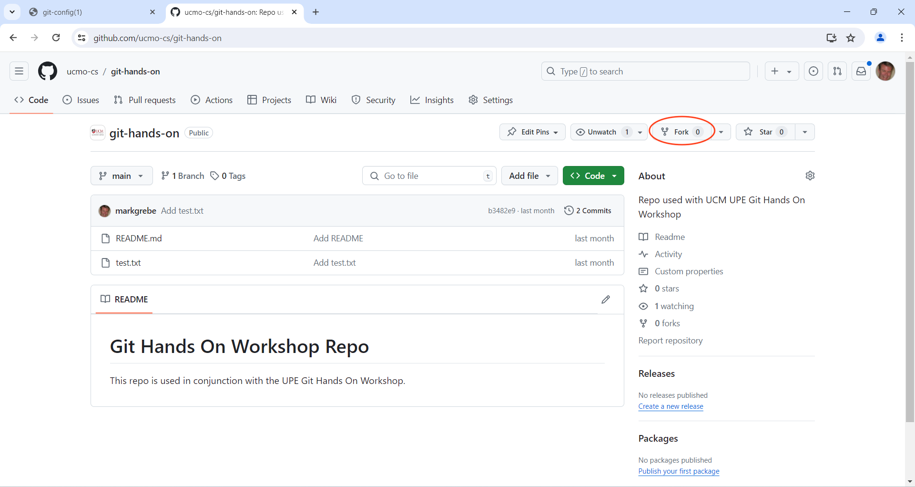

Slide 27
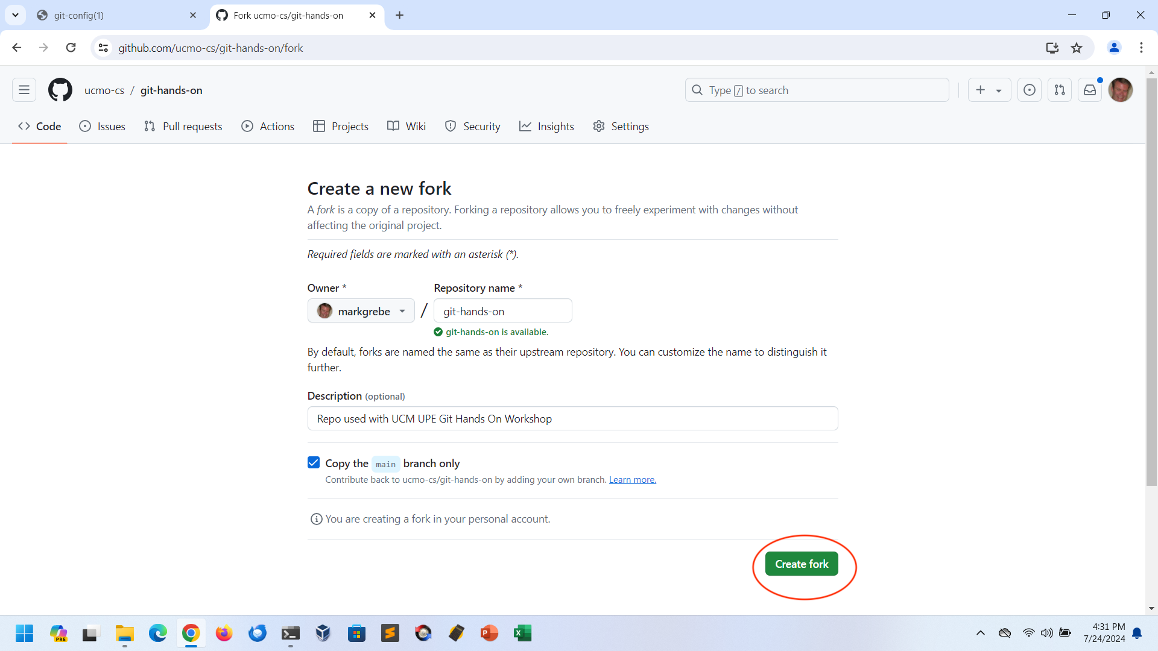

Slide 28
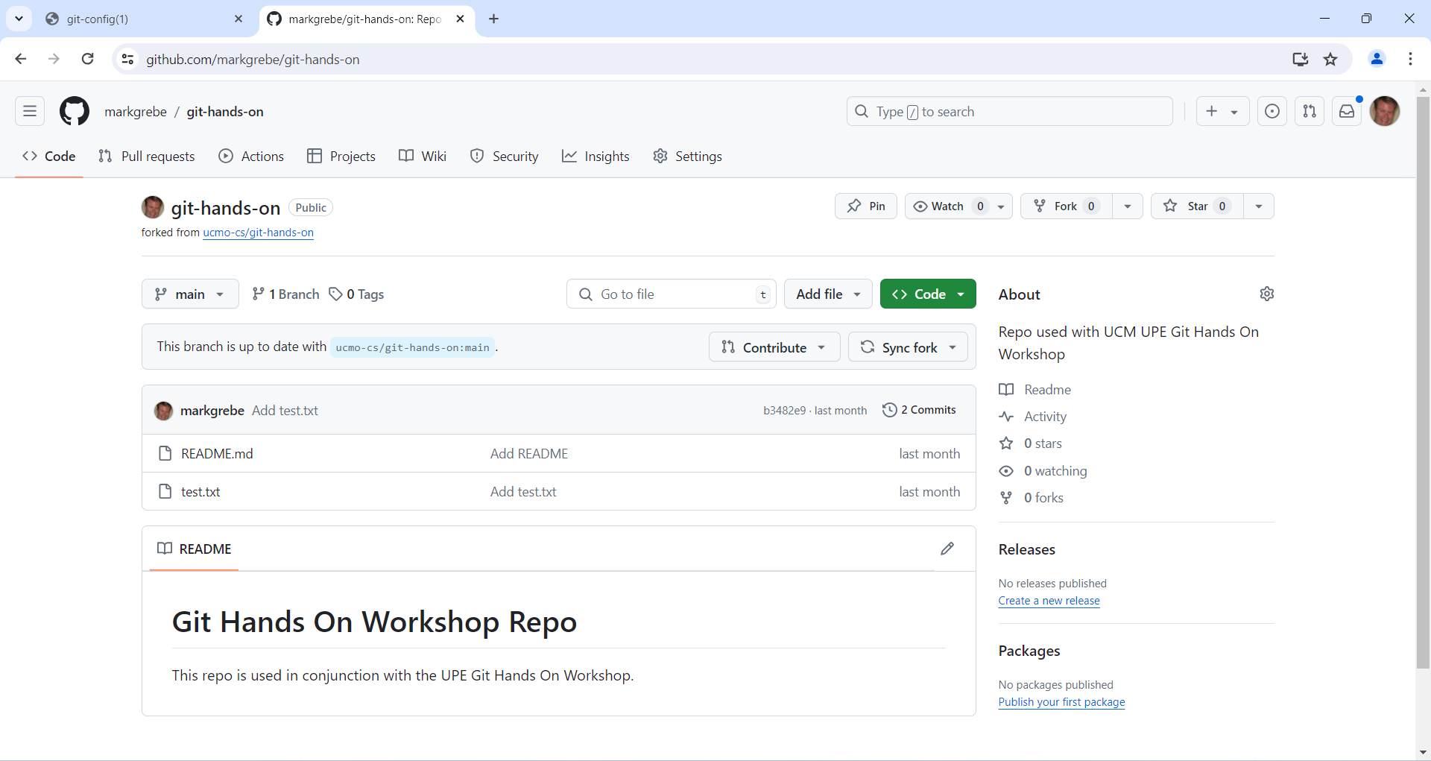

Slide 29
Section 5
Push To A Remote Repo
Screenshots

Slide 30
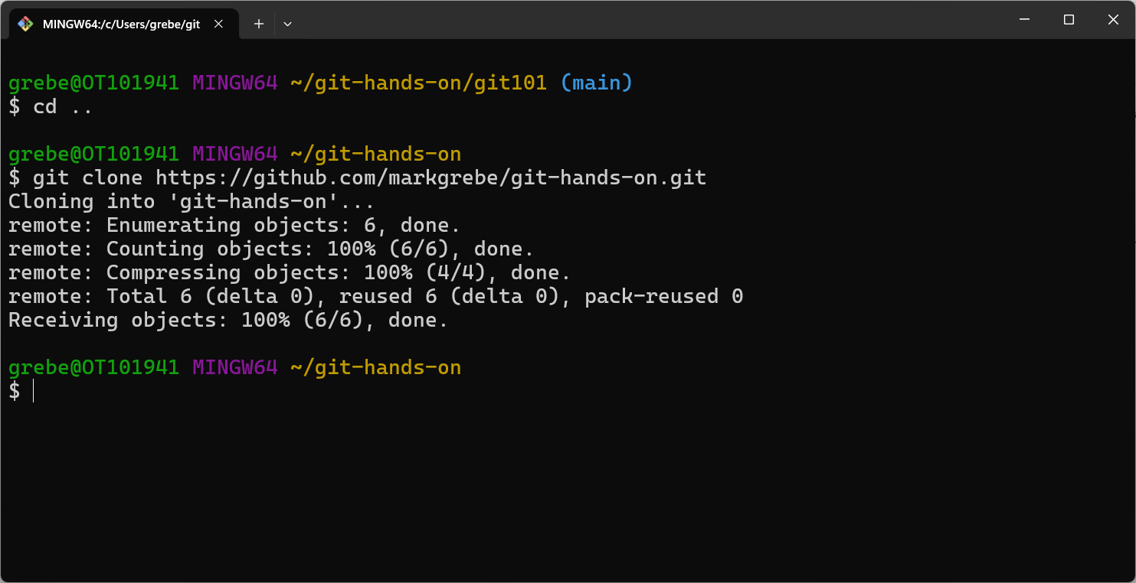

Slide 31
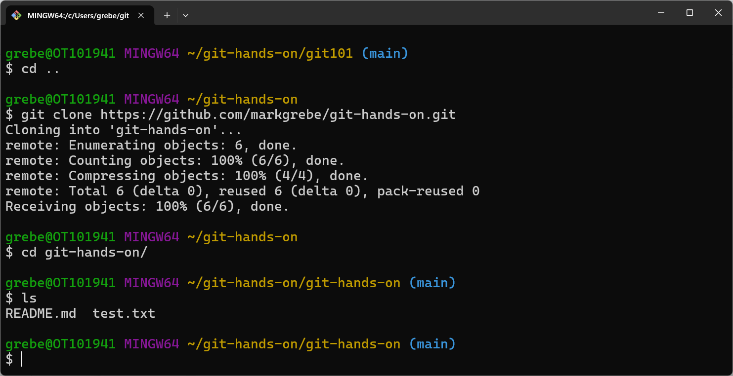

Slide 32
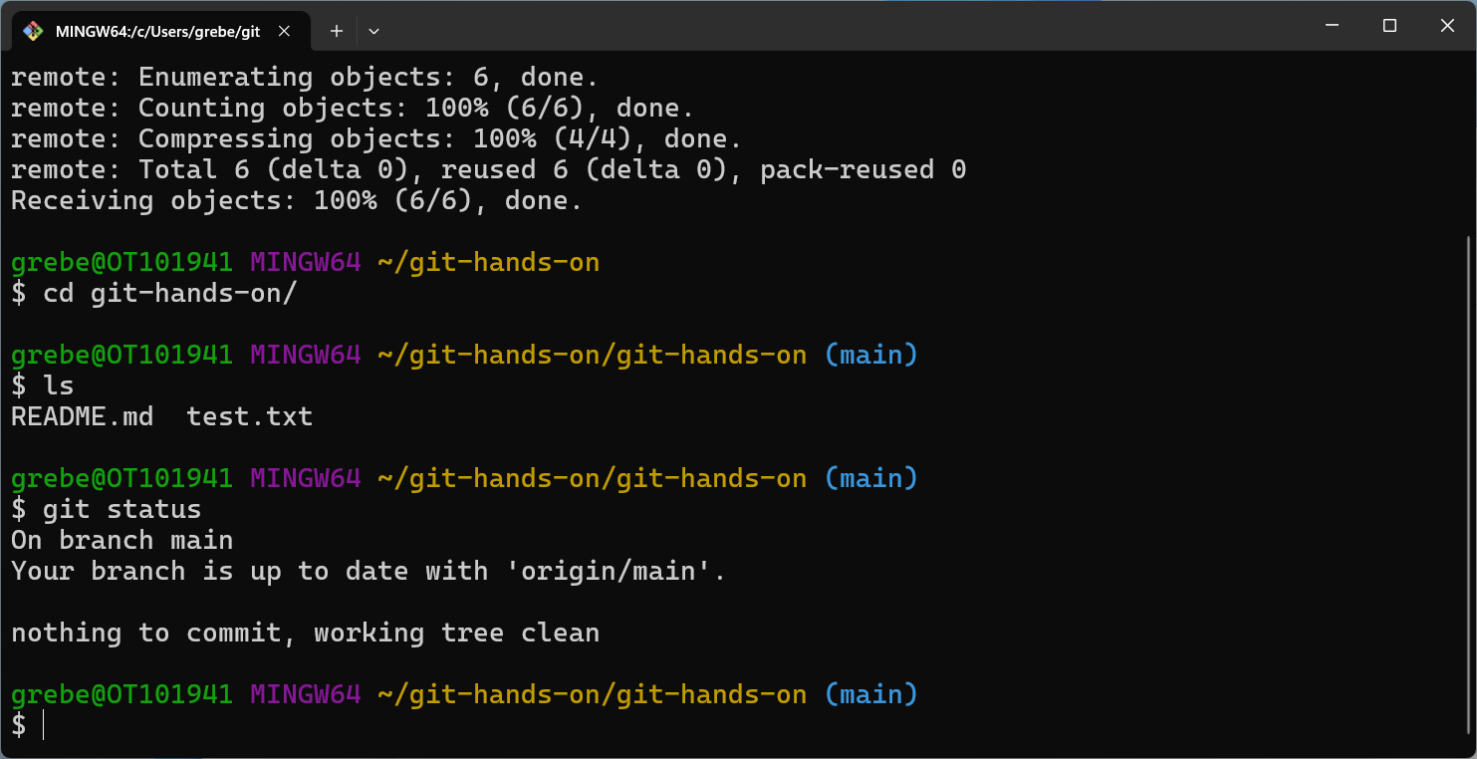

Slide 33
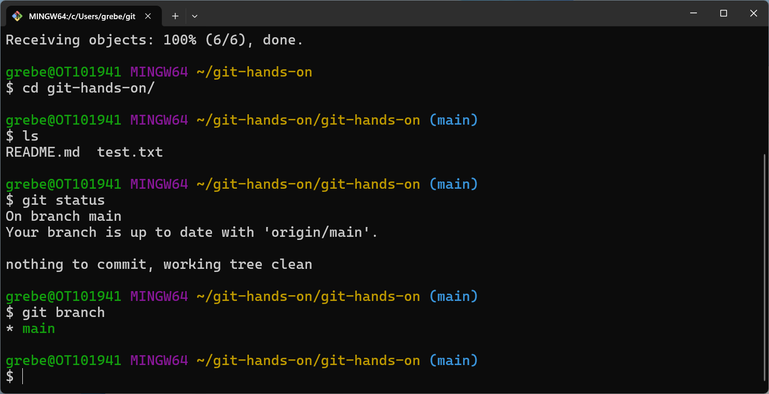

Slide 34
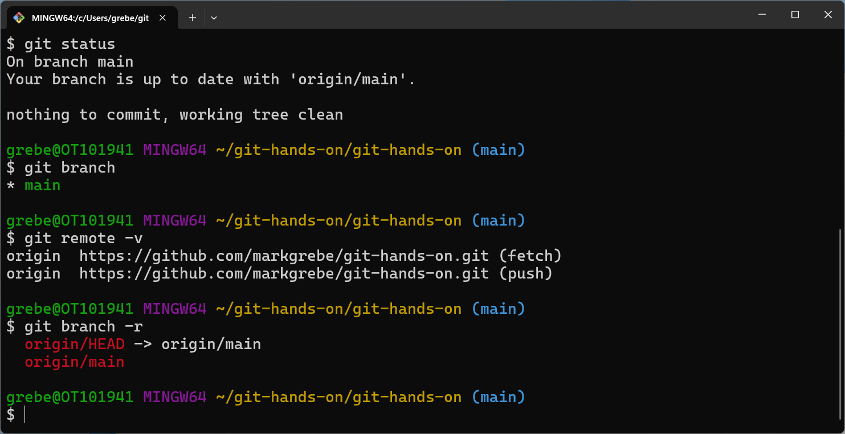

Slide 35
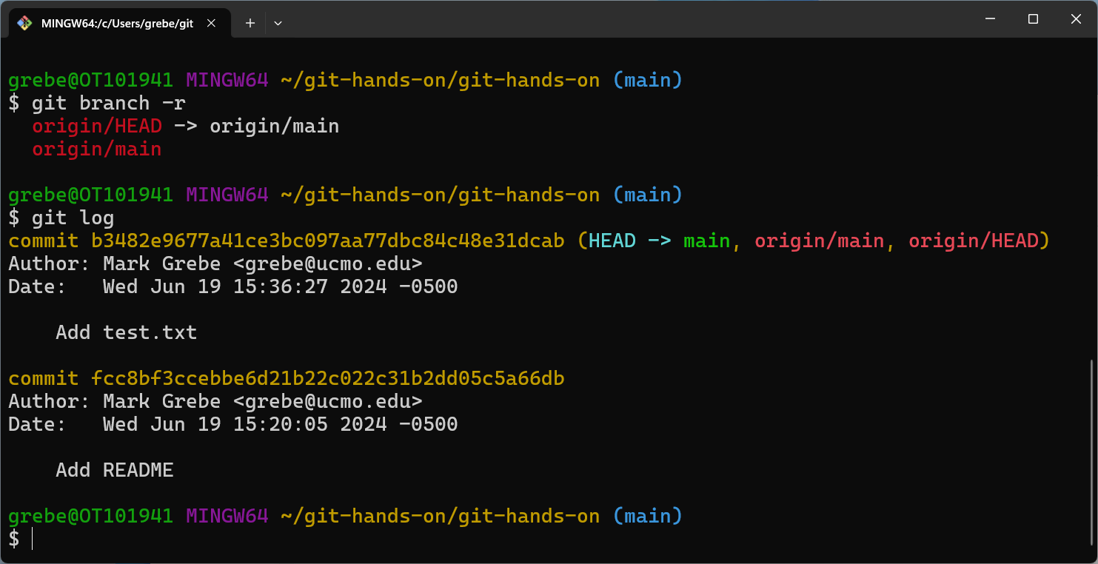

Slide 36
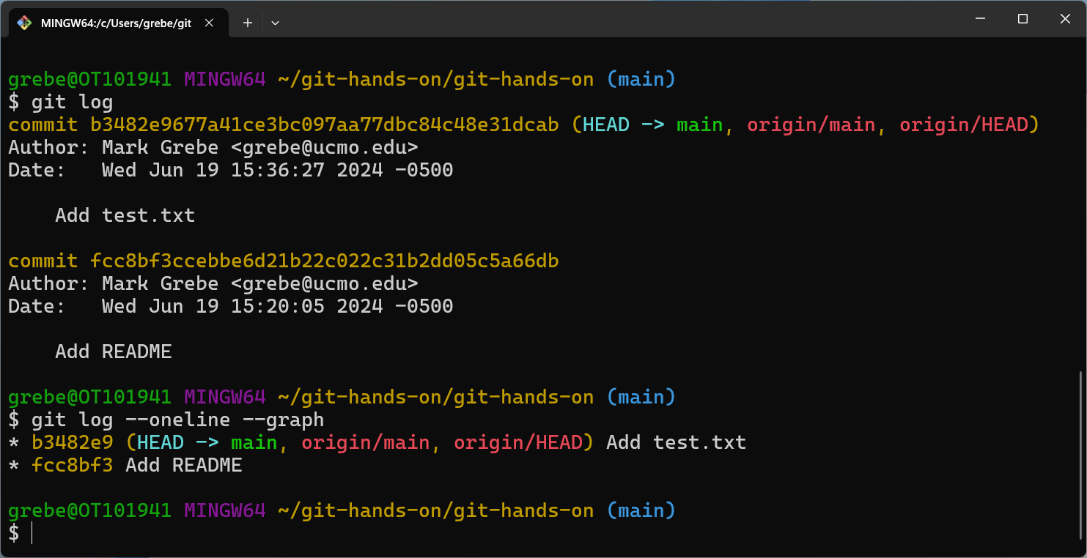

Slide 37
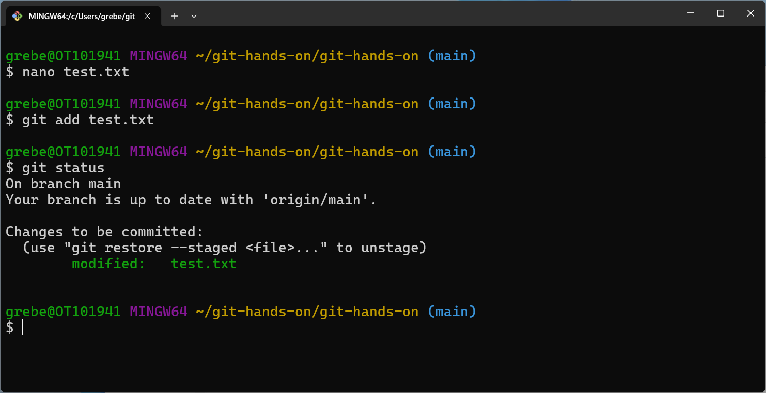

Slide 38
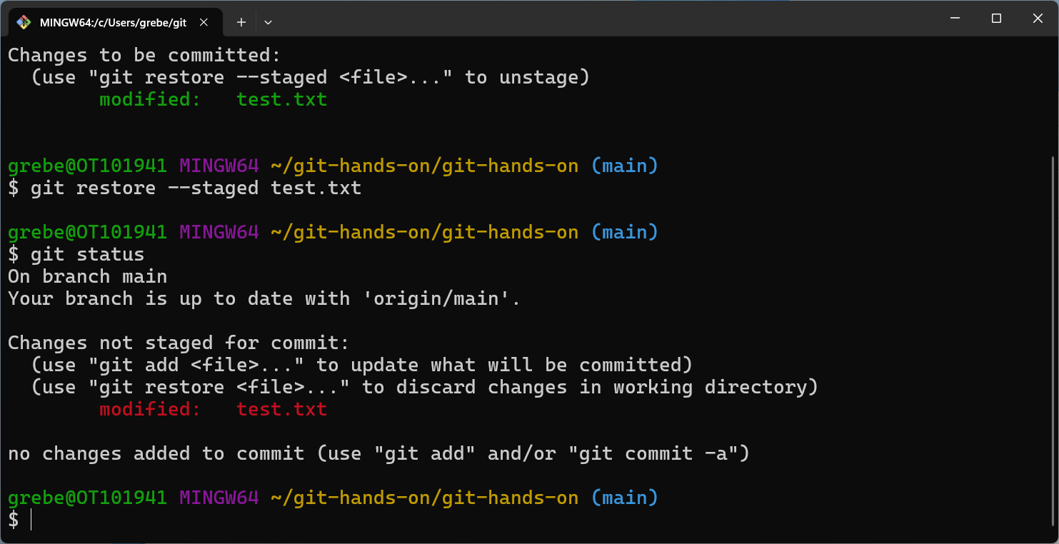

Slide 39
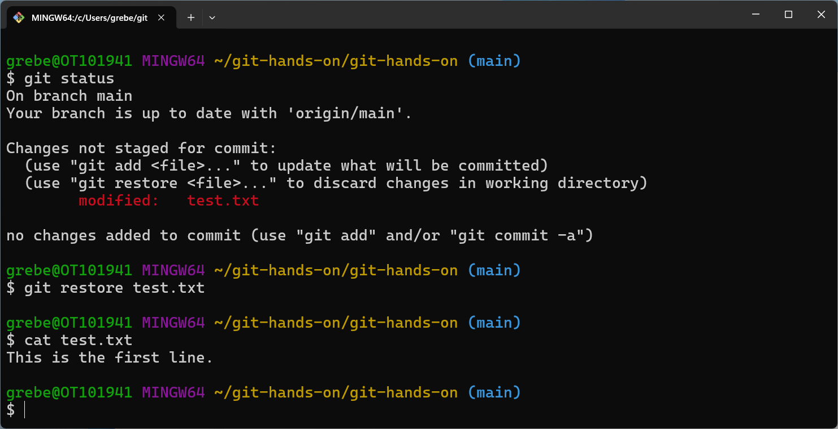

Slide 40
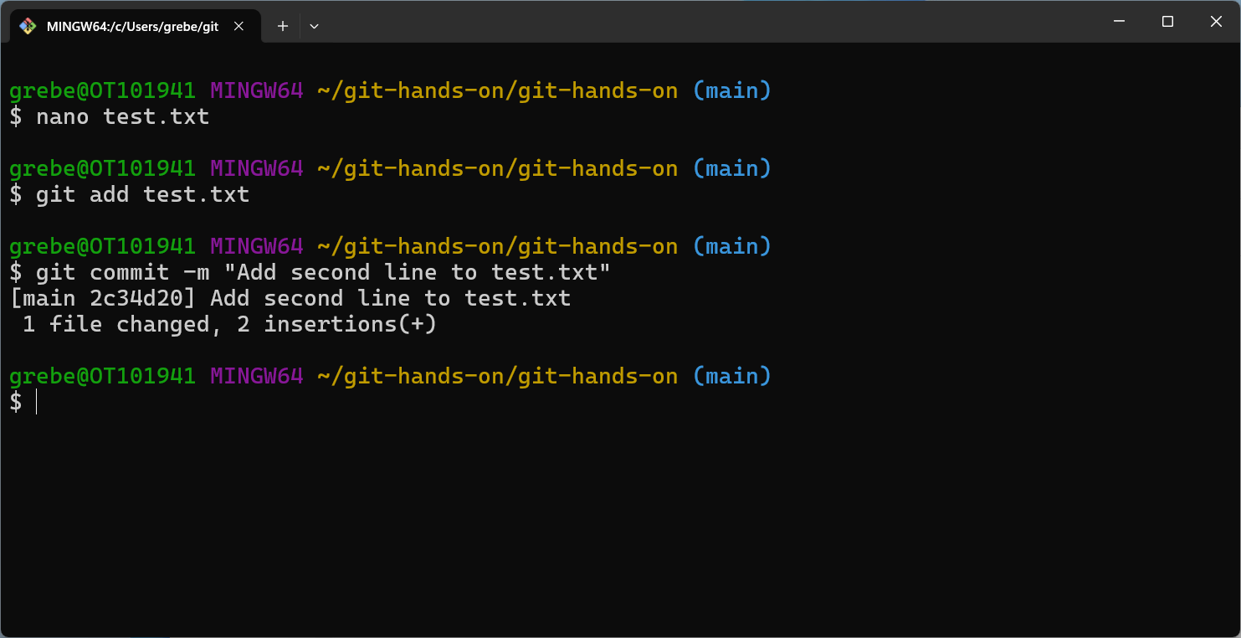

Slide 41
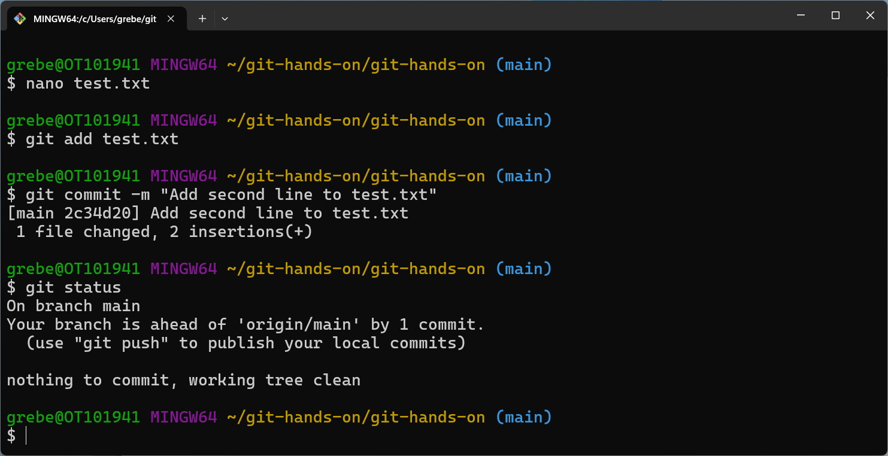

Slide 42
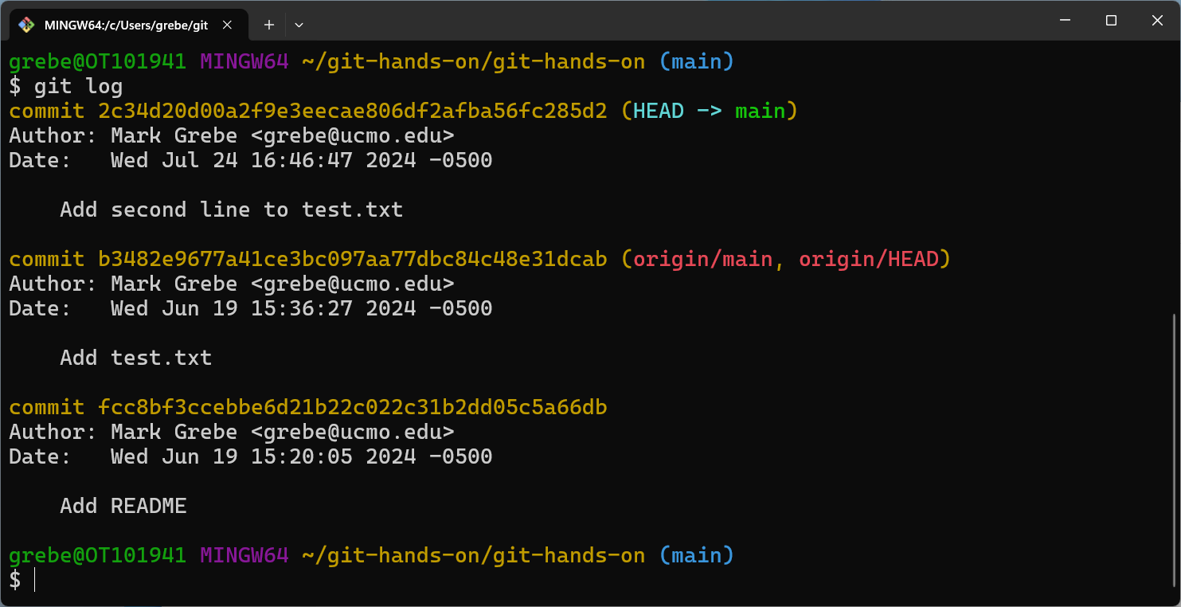

Slide 43
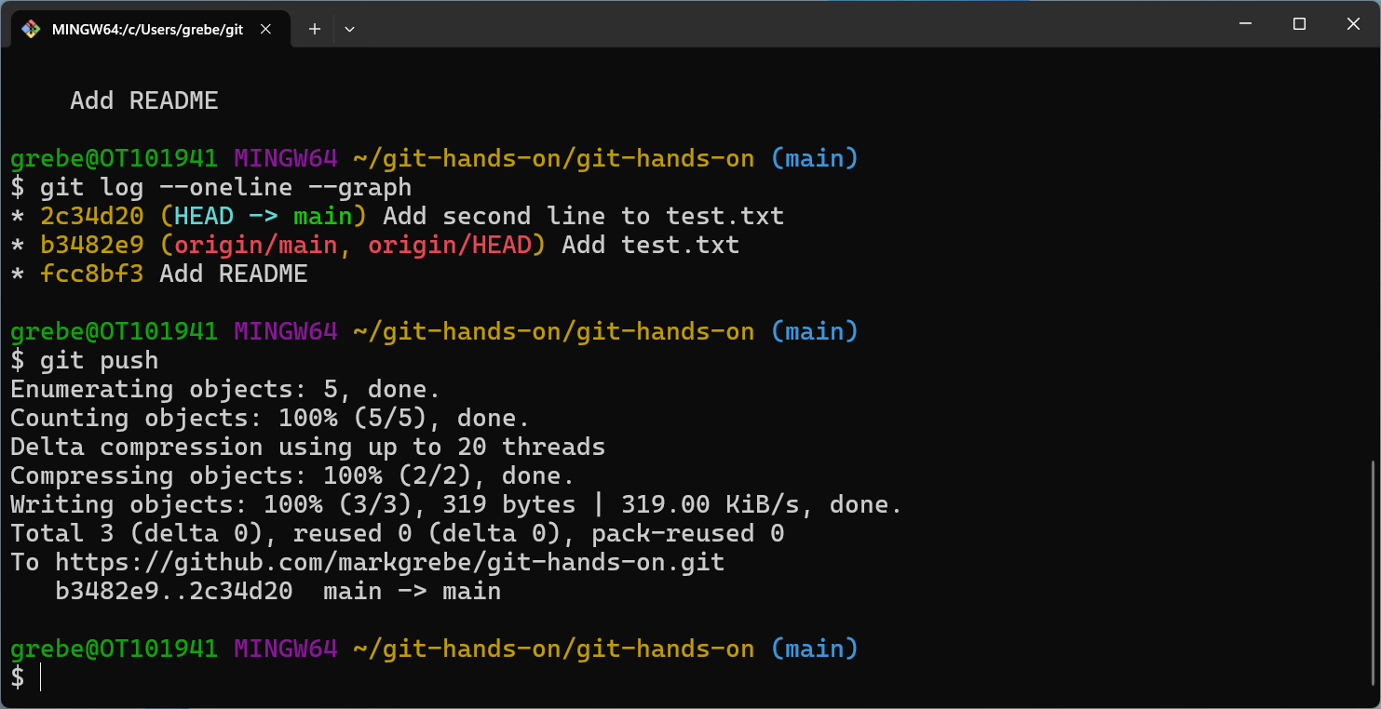

Slide 44
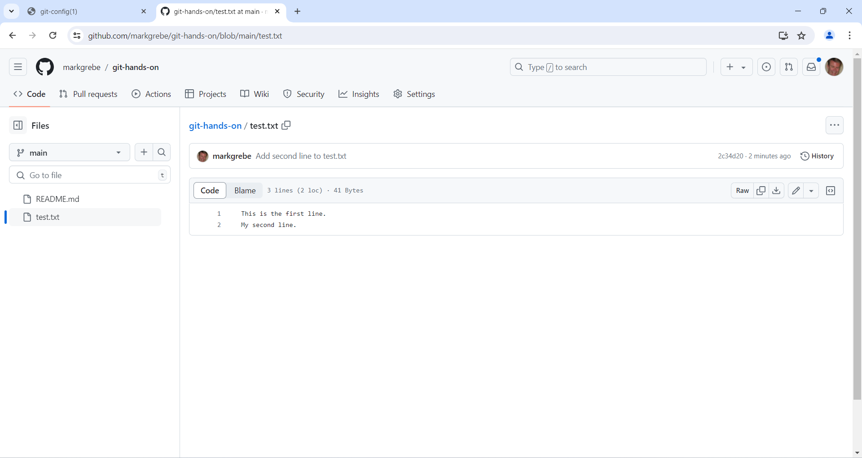

Slide 45
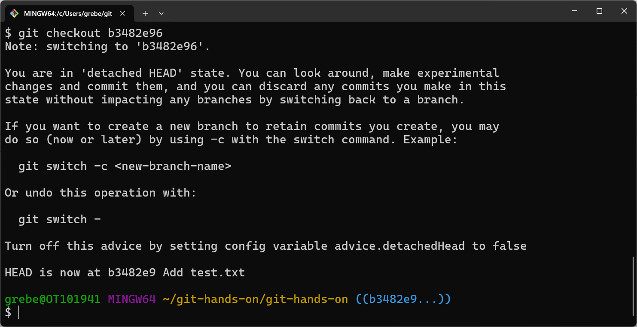

Slide 46
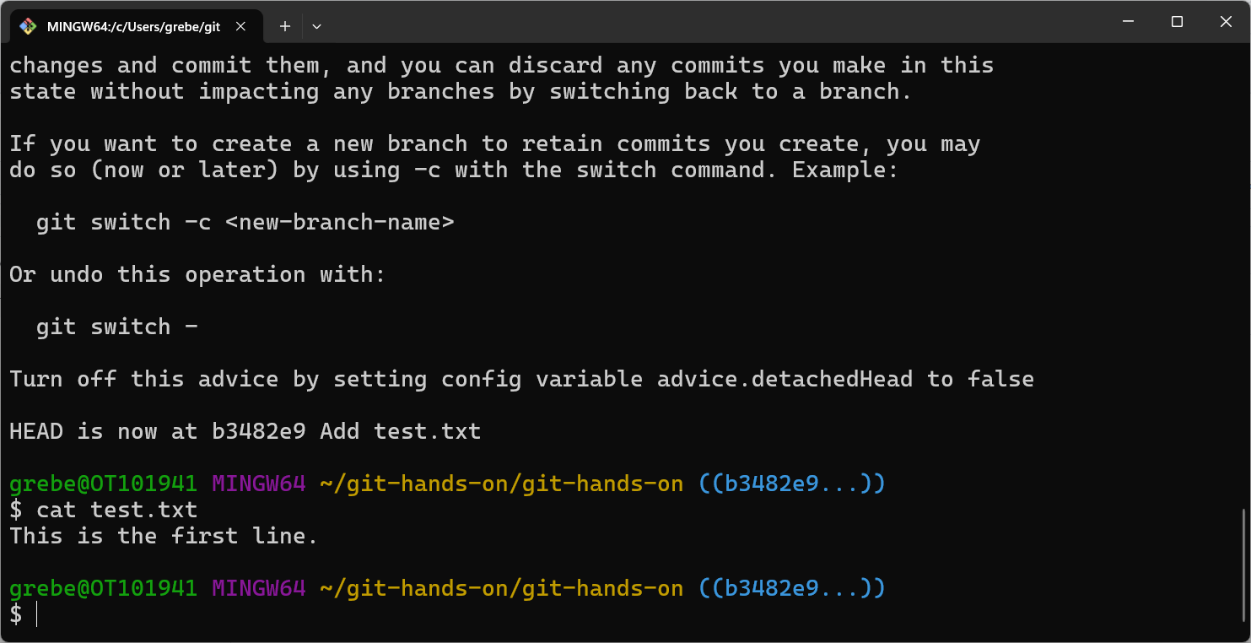

Slide 47
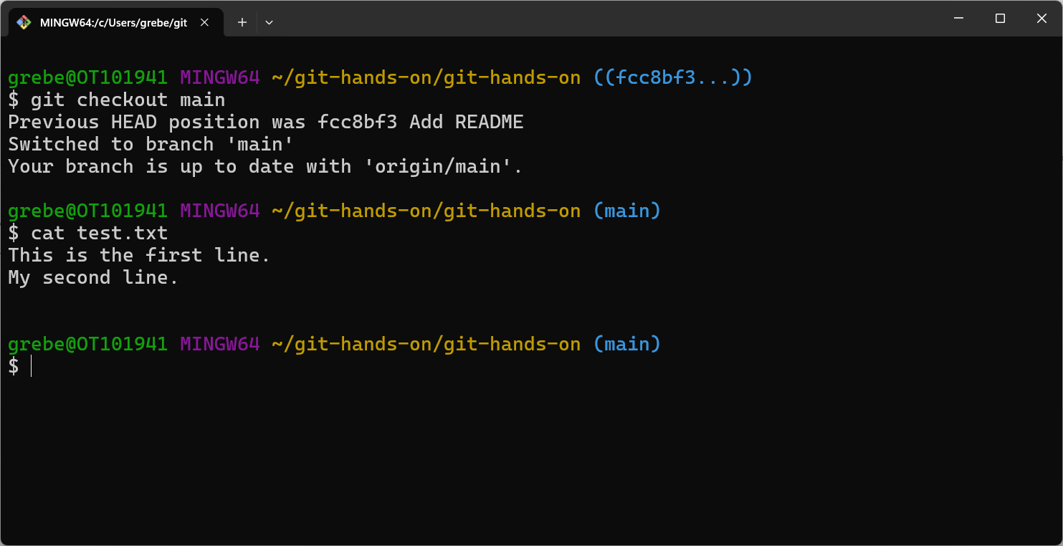

Slide 48
Section 6
Working Locally With Branches
Screenshots

Slide 49
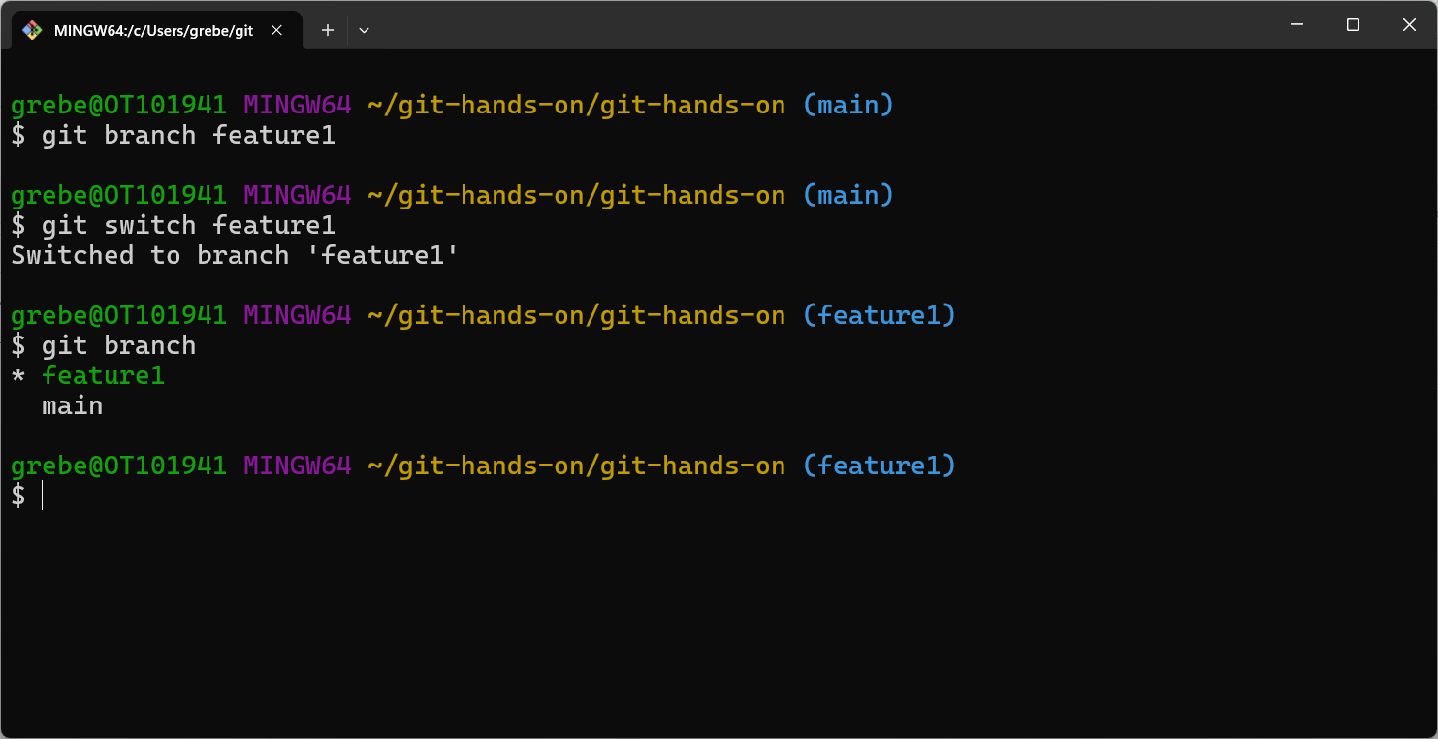

Slide 50
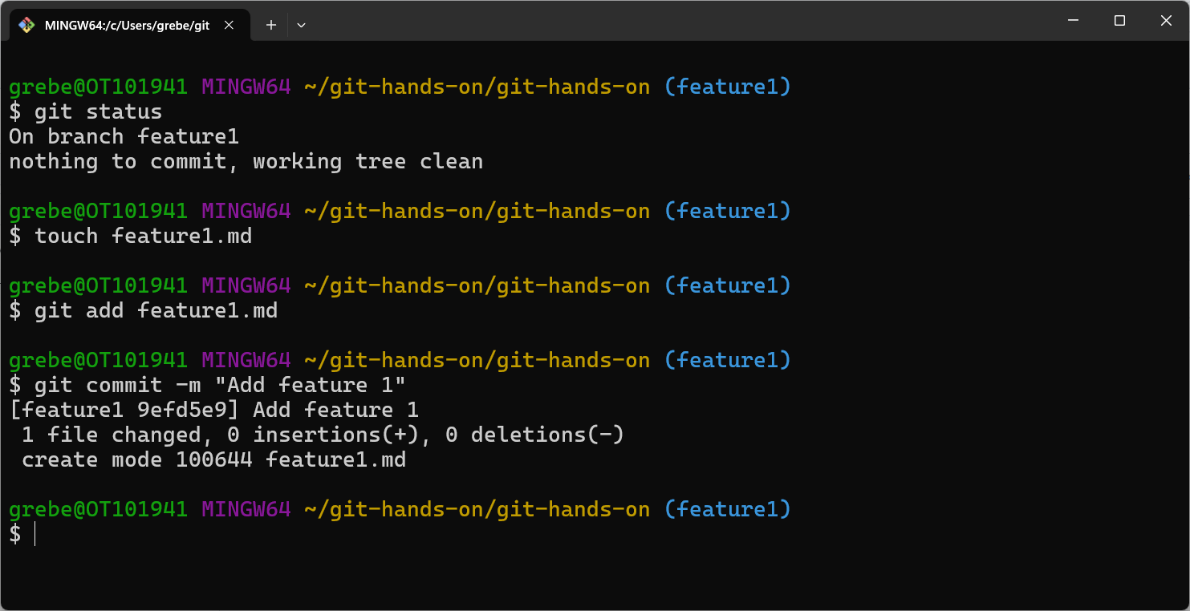

Slide 51
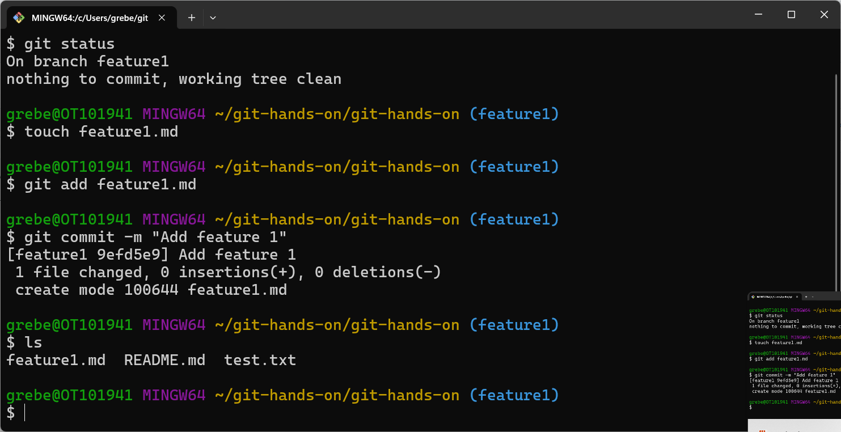

Slide 52
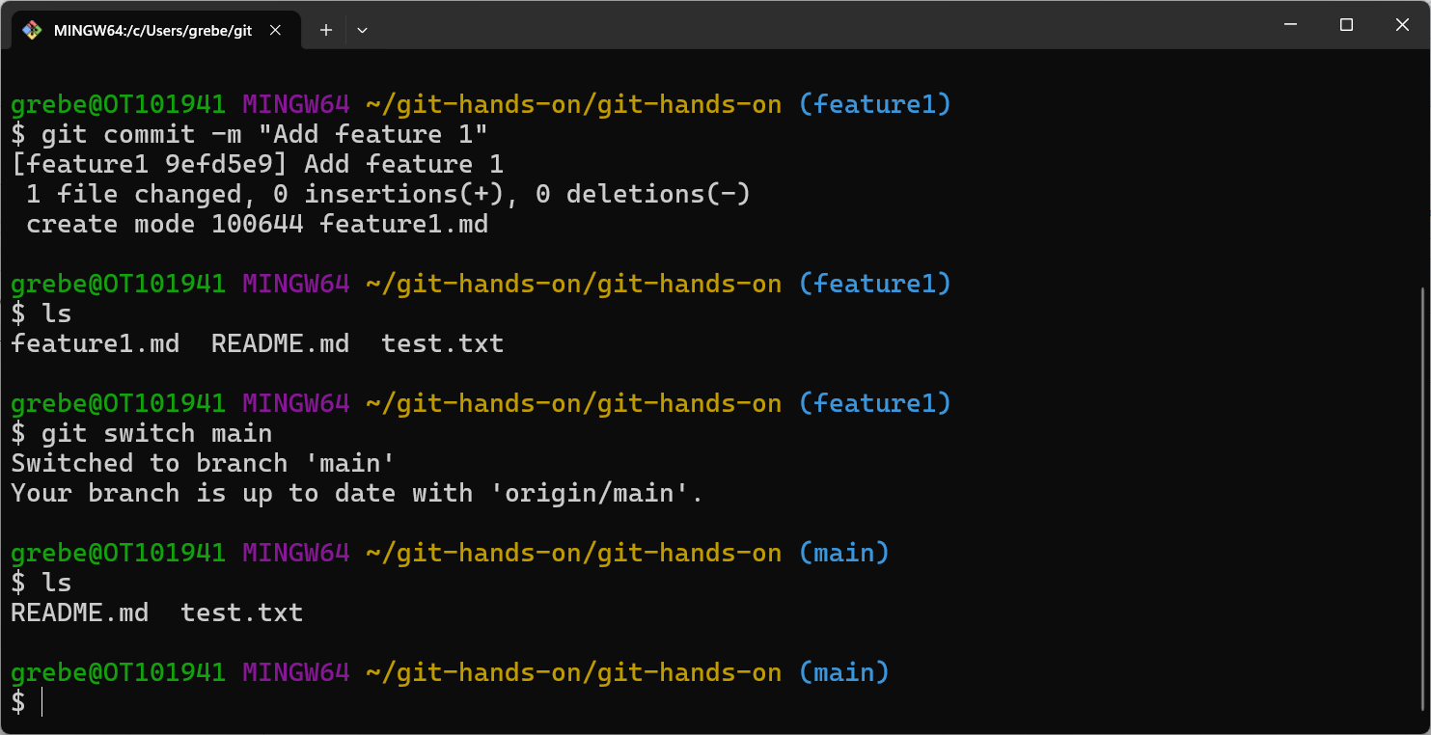

Slide 53
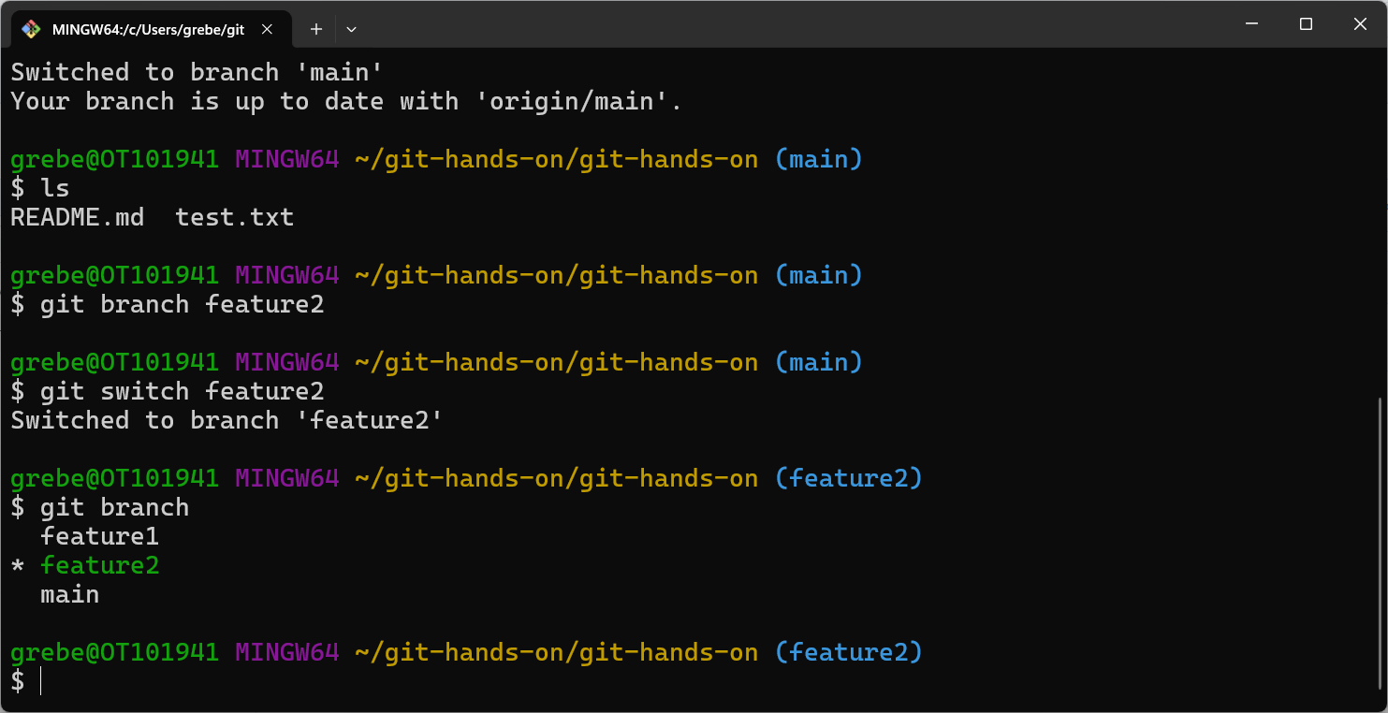

Slide 54
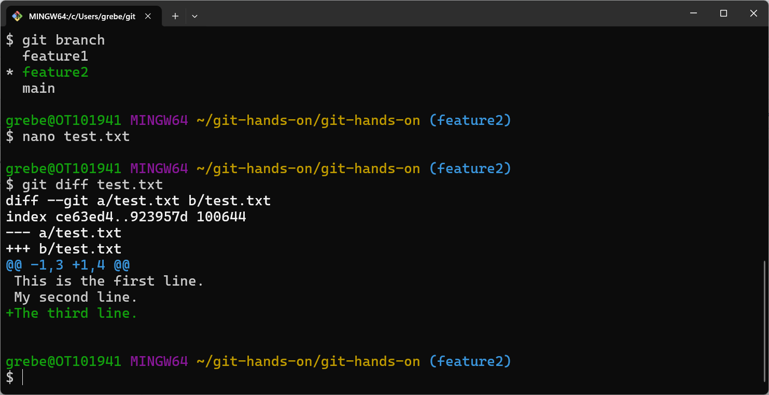

Slide 55
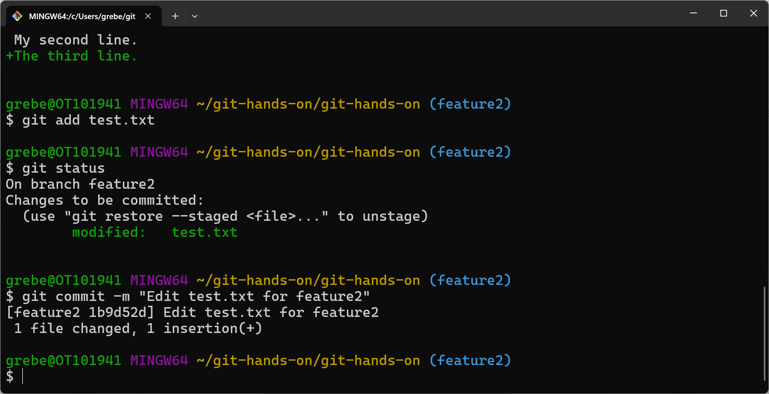

Slide 56
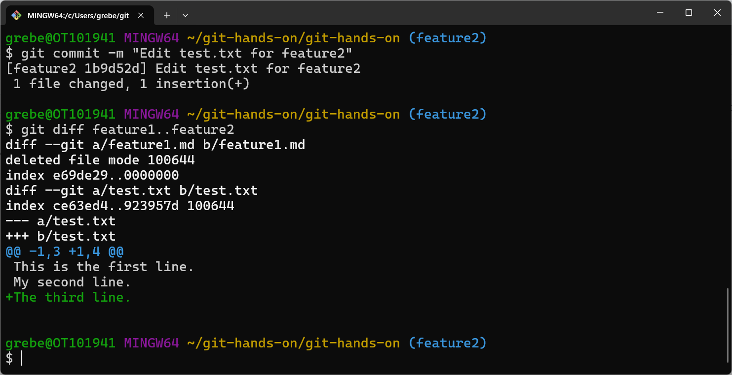

Slide 57
Section 7
Working Remotely With Branches
Screenshots

Slide 58
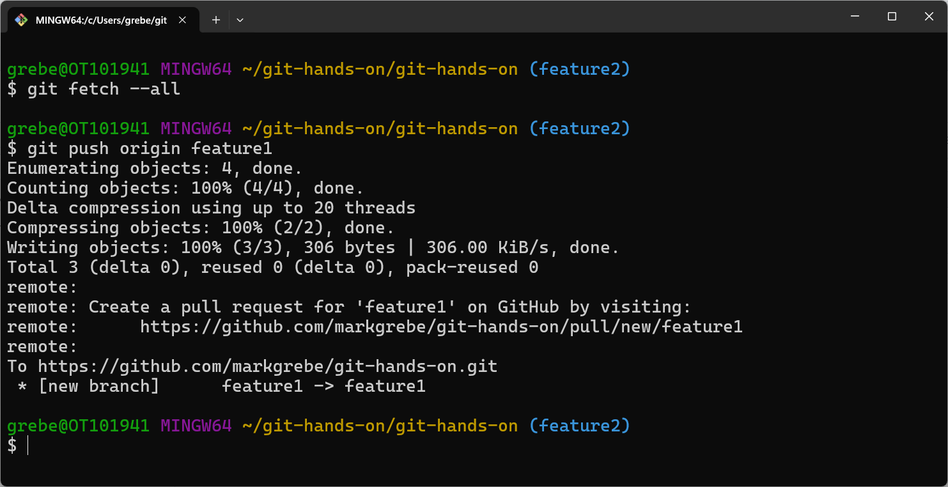

Slide 59
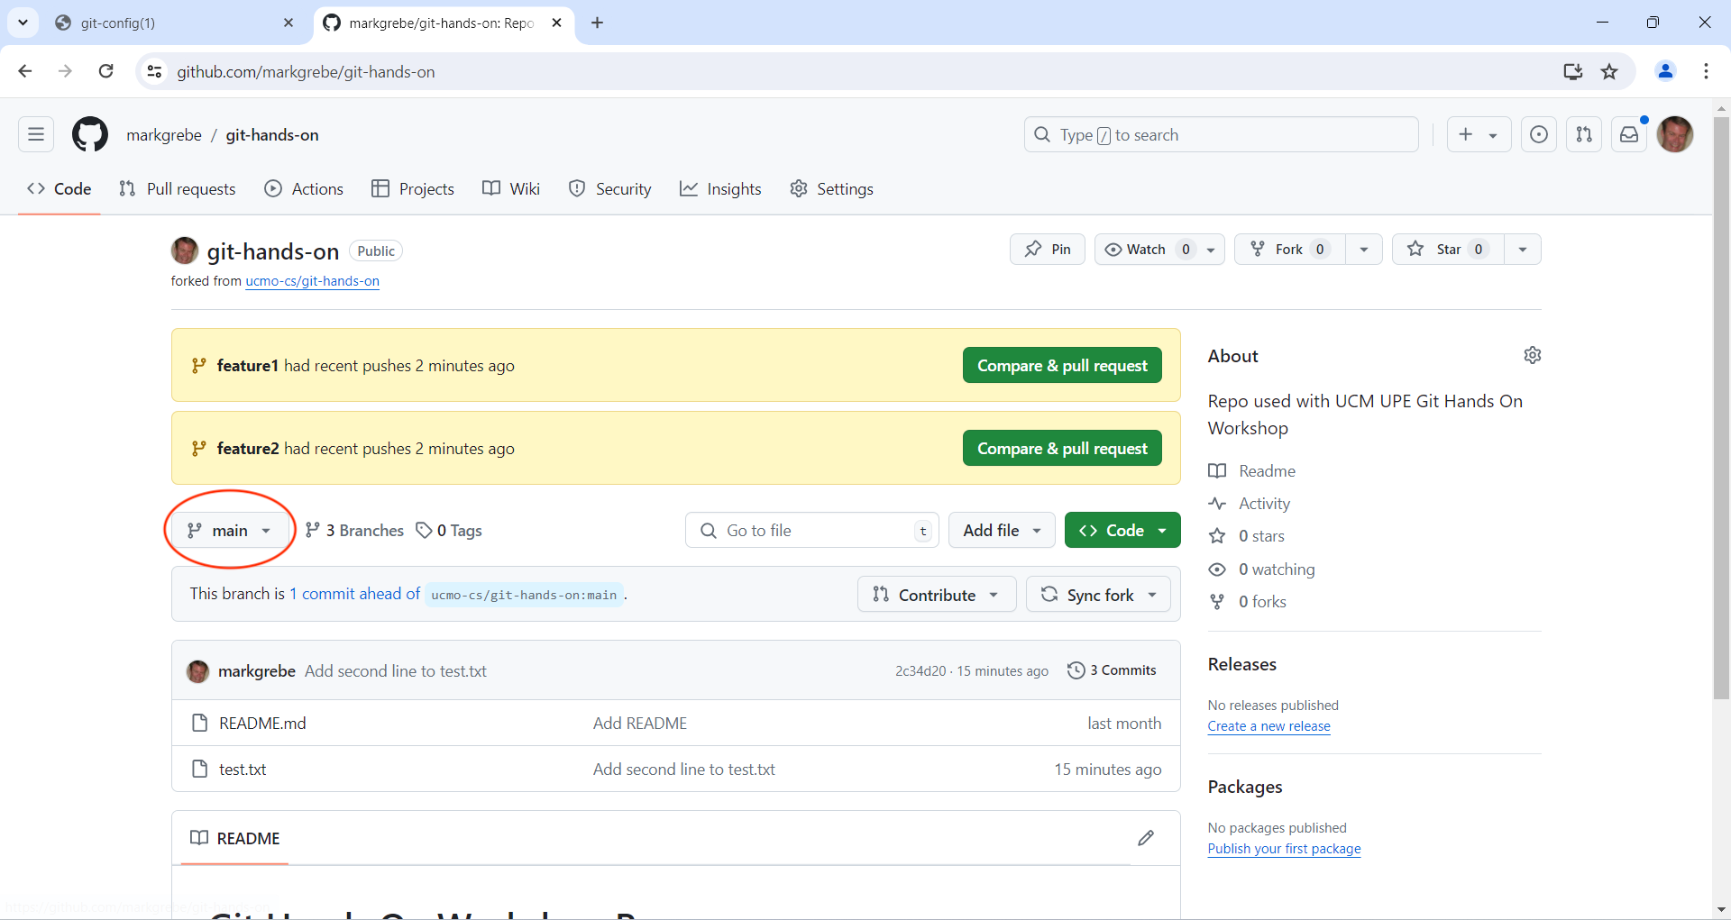

Slide 60
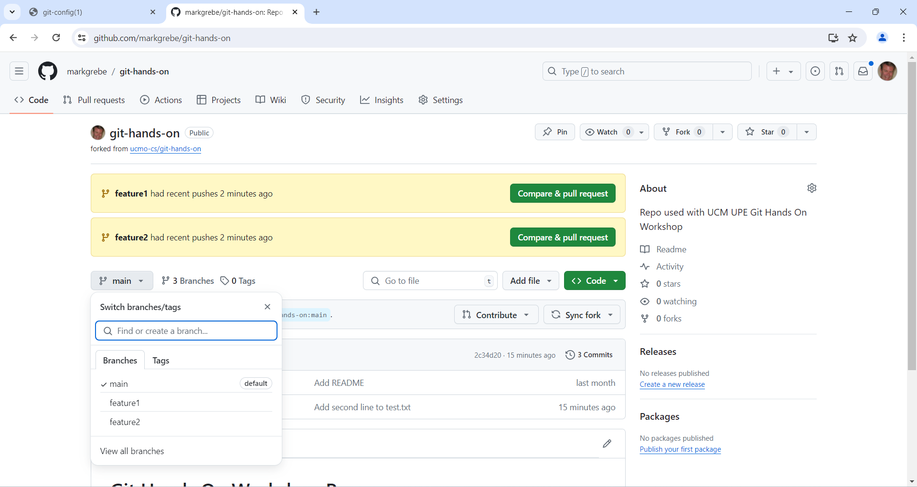

Slide 61
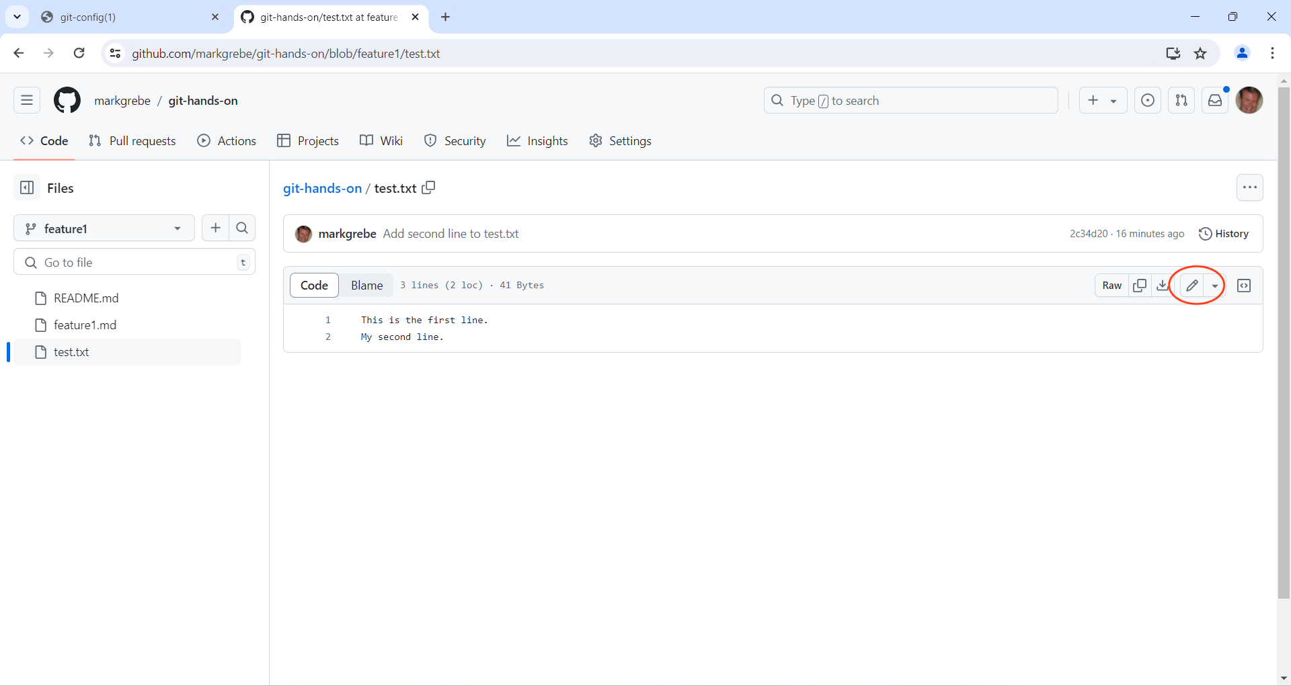

Slide 62


Slide 63


Slide 64


Slide 65
Section 8
Merging
Screenshots

Slide 66


Slide 67


Slide 68


Slide 69


Slide 70


Slide 71


